Slide 1
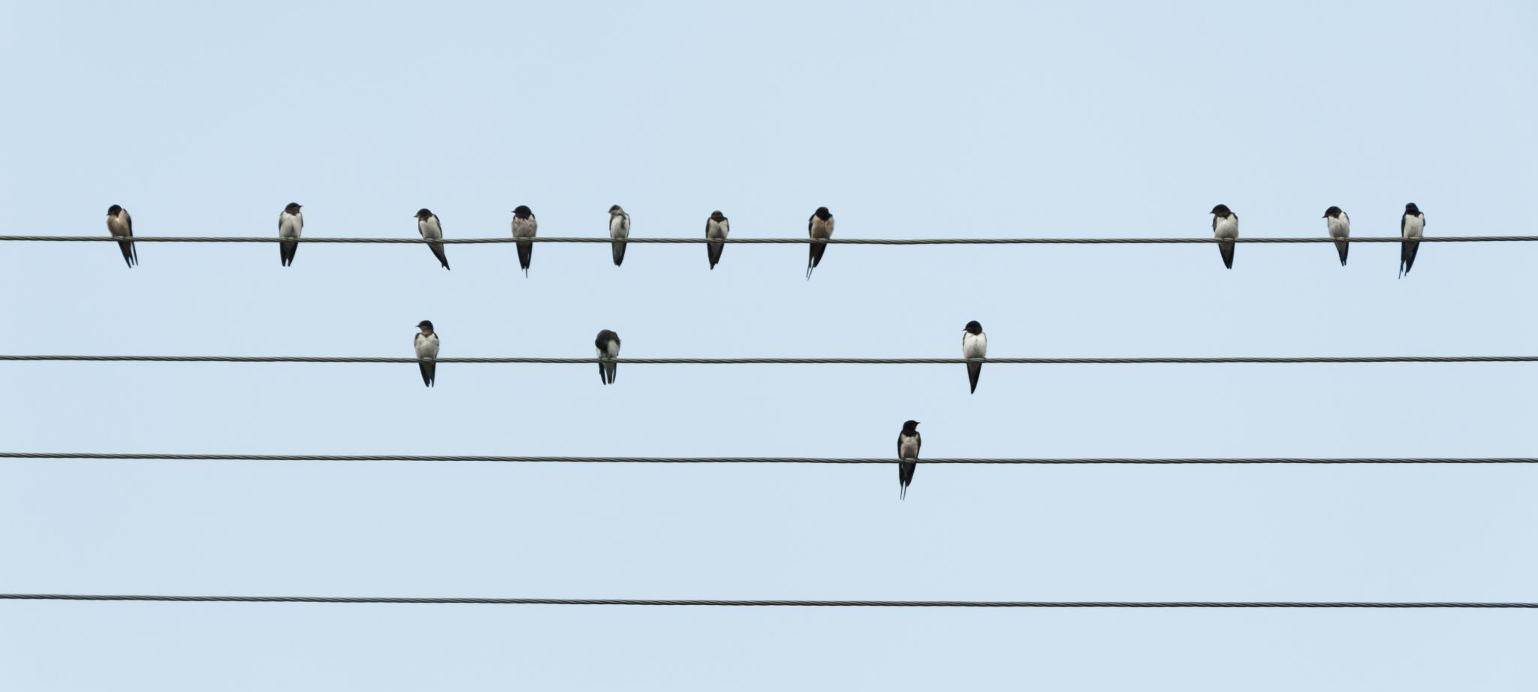

Using Large Language Models to engage with citizen science data
Dr. Elise Gallois
elise.gallois@nhm.ac.uk
Notes:
Hi there! I’m going to be presenting some use cases for encouraging ecologists to make use of quantitative LLM tools for their big data requirements

Slide 2





Large Language Models
Deep learning algorithms trained on textual data
Perform Natural Language Processing tasks
Can recognize, predict, translate, classify, and generate text
Notes:
We’re all fairly familiar with LLMs in this crowd. These are deep learning algorithms trained on text, and good at reconition classification and translation tasks.

Slide 3
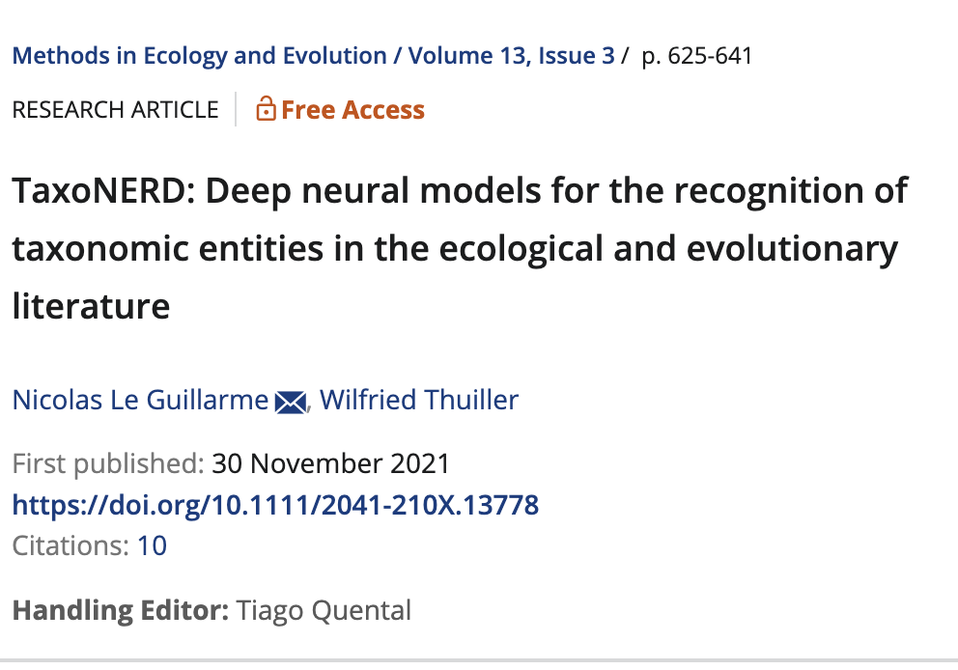
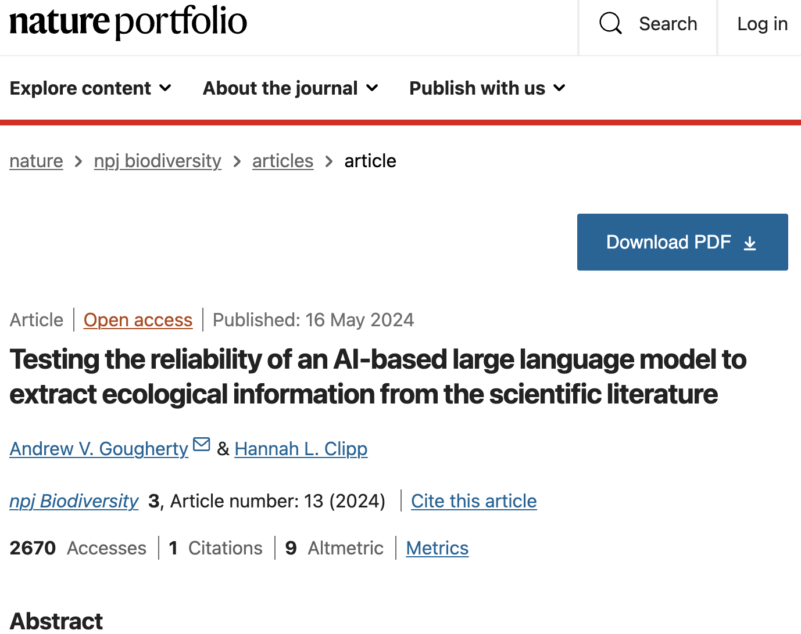
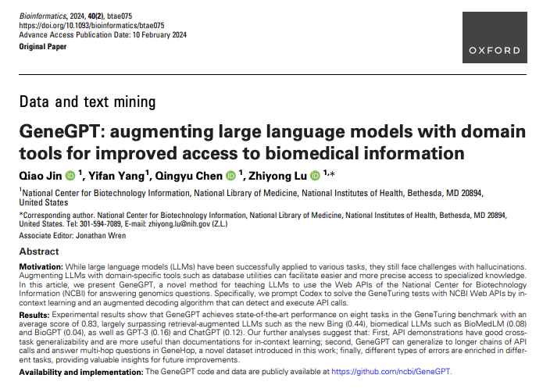
Scientific Use Cases
Notes:
Within ecology and medicine, there have been some good attempts at using LLMs to scrape text from literature, but as yet not quantitative research even though LLMs are developing decent mathematical properties

Slide 4

eBird
Widely used global database of bird observations
Updated daily
Moderated / anomalies checked (but still liable to bias)
Data in matrix format
Notes:
So for this exploration I was looking at eBird which is a global citizen science database where users upload bird observations. Moderated by experts. Can be loaded in near realtime as an API pull

Slide 5
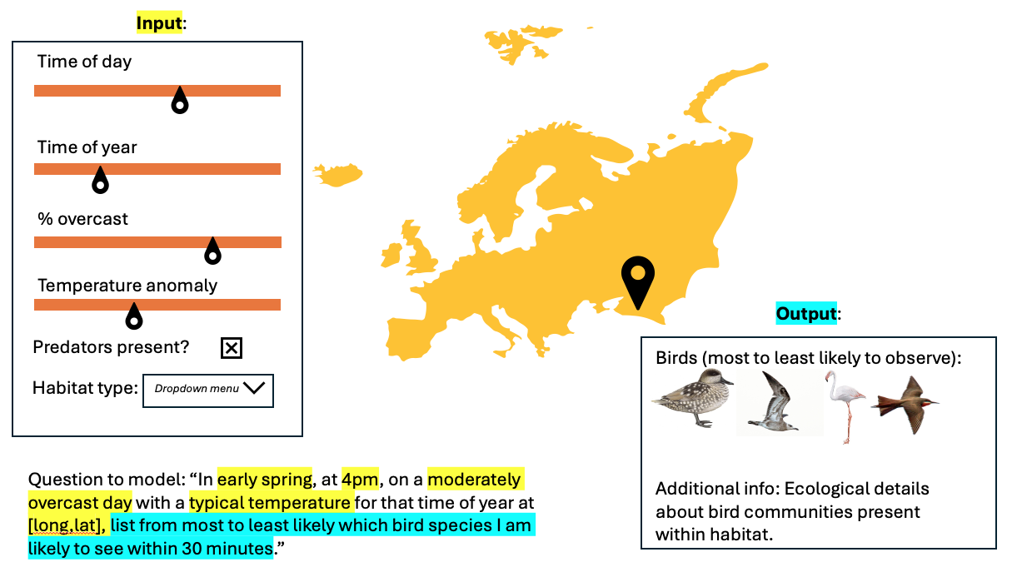
Example ecology use case
Notes:
An example use case for an ecologist could be this. The LLM tools summarise the dataframe, the user inputs their query, which is then converted to a text based prompt and then the output is a reasonable community of birds

Slide 6



LangChain
User query
Helpful prompts
Tools
Chatbot response
Notes:
For this I used langchain which is a software library that hooks up to pretrained LLMs and you can add in custom toolkits such as the SQL tool which runs mathematical functions. You can also attach your own prompts, and really prompt engineering goes a long way with this analysis,

Slide 7
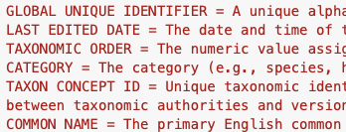
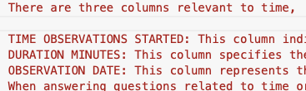
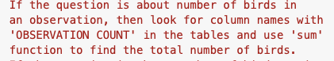
Prompt Engineering
Or “teaching a birdbot to tell the truth”
Metadata
Explanation of abstract concepts
Example Q&As
Helping the chatbot define the task, recognise the inputs, and tackle the questions using a framework.
Notes:
So I took an iterative approach of starting with no prompt, then adding ebird metadata, then adding some explanations, then some few shot examples

Slide 8
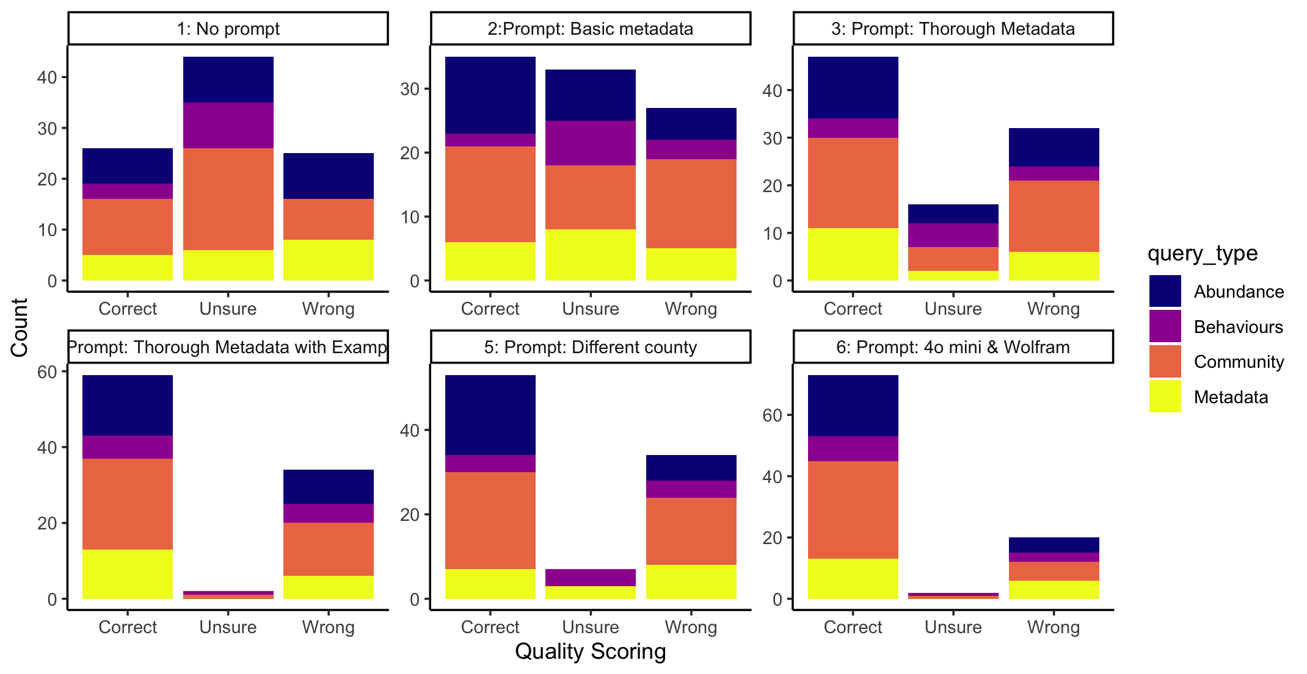
Iterative model improvements
Notes:
I had a bank of 100 questions that I tested in the different model versions covering different types of ecological reasoning. Started with no prompt, then you can see the ratio improves when you add to the pormpts. I tested too against a different counties data. Then finally when 4o mini was release I also used that and a wolfram alpha tool to help run the calculations

Slide 9
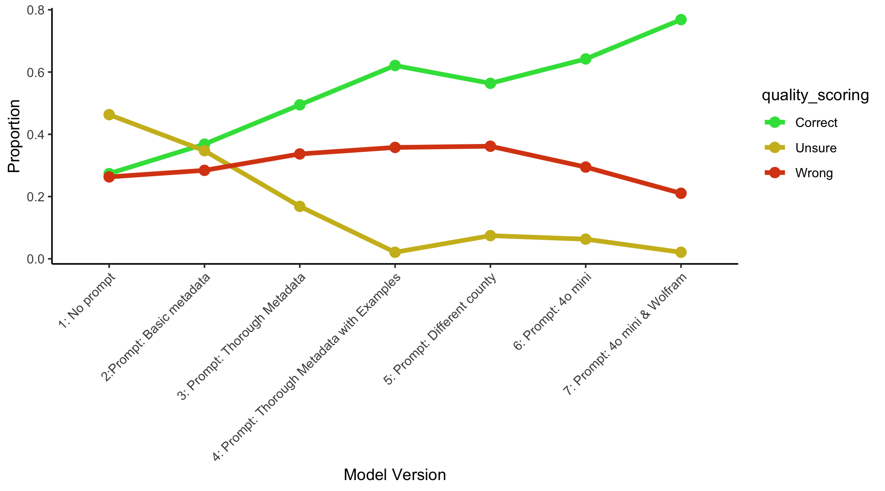
Notes:
You can see here how the model can be iteratively improved over time.

Slide 10
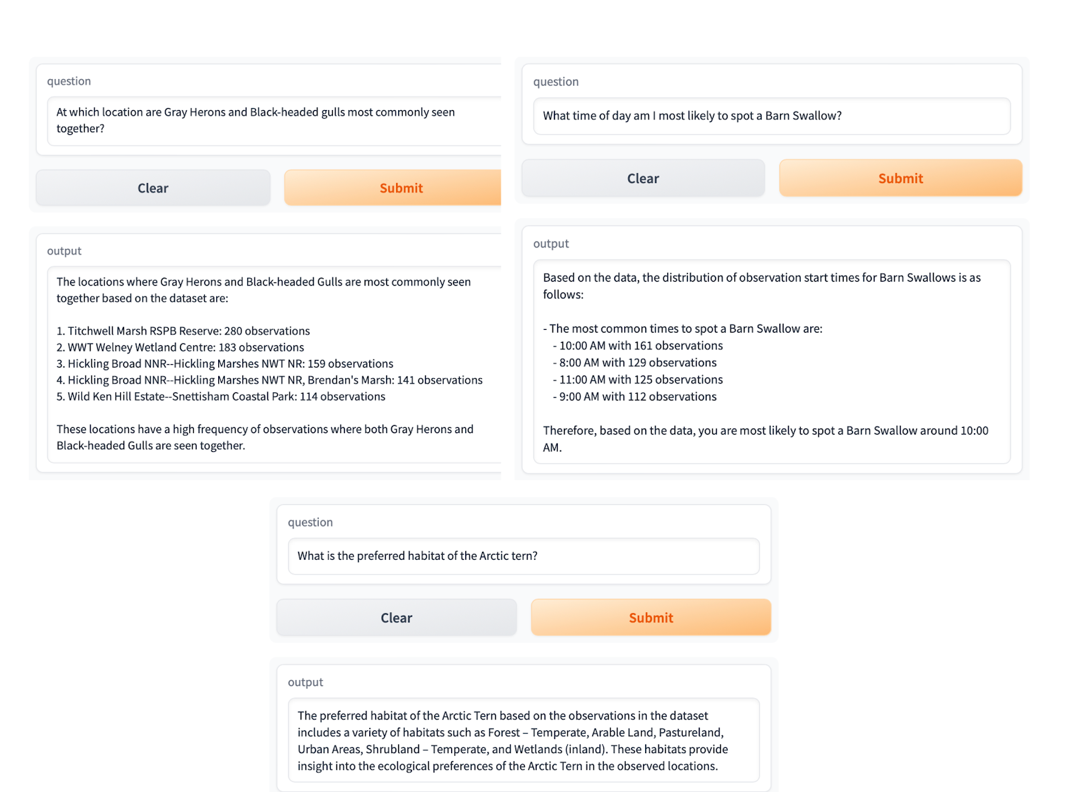
Notes:
Some outputs

Slide 13
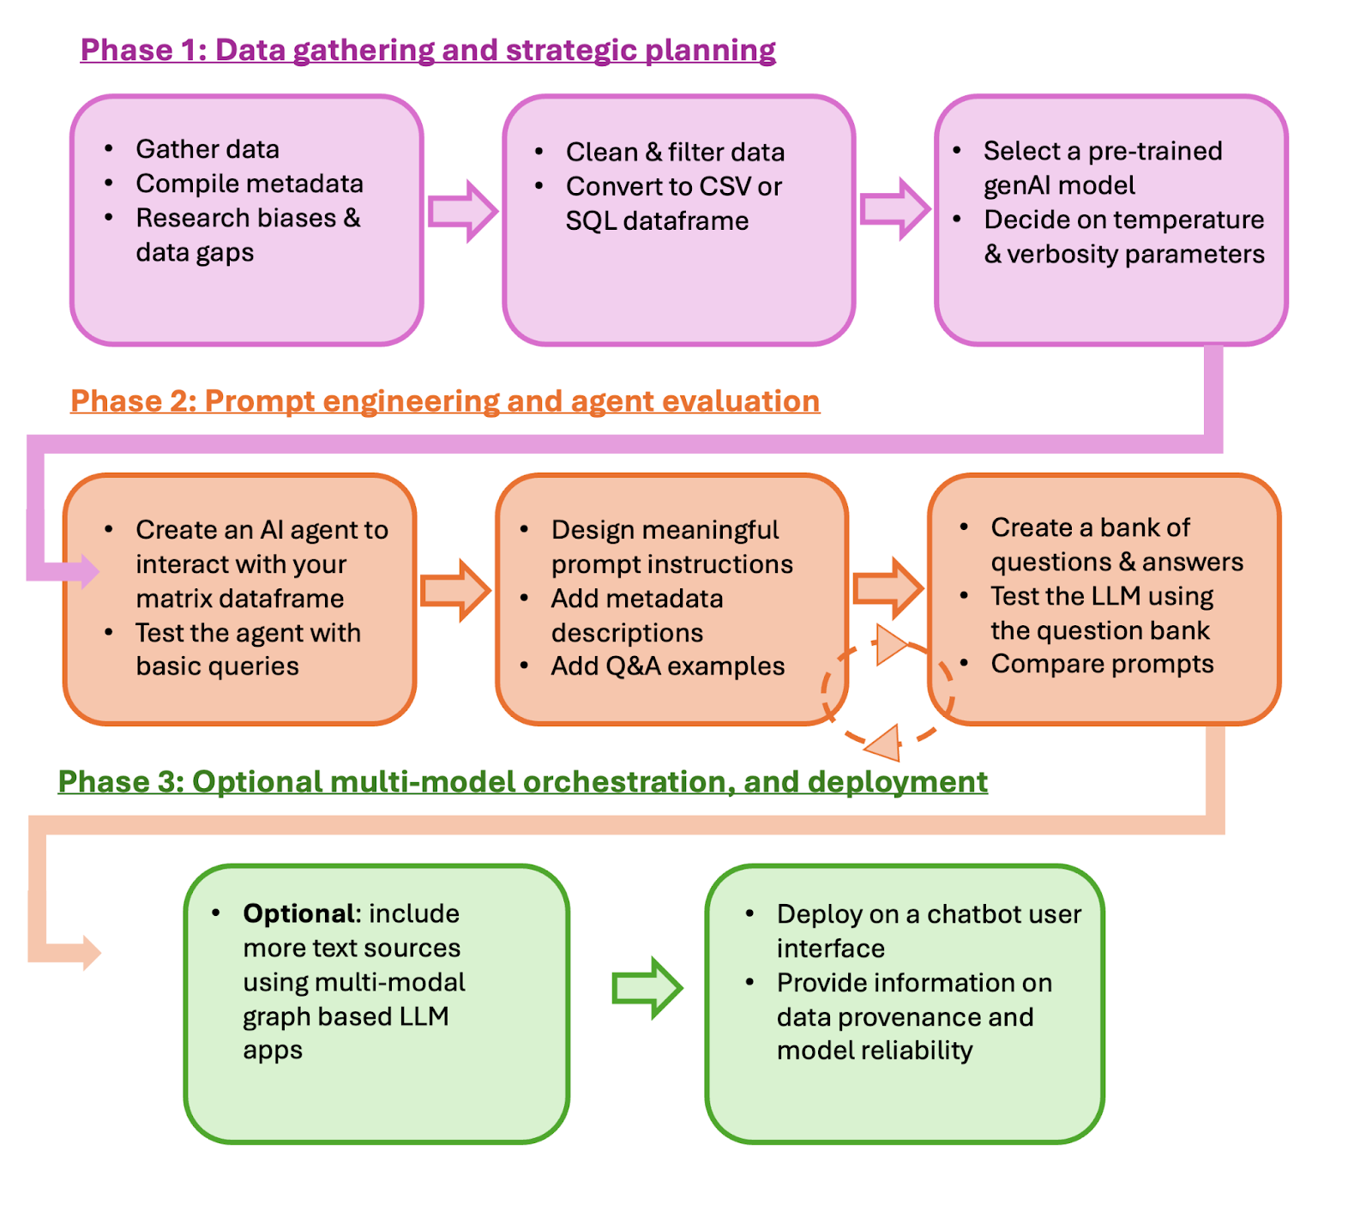
A prospective framework
A roadmap for ecologists wishing to develop quantitative LLM tools
Pre-print coming soon!
Notes:
So in my experience, ecologists largely work in R, and this is a really untapped tool. So I’m working on building a roadmap to showcase to ecologists how to develop LLM RAG models, from data gathering and choosing model parameters, to prompt engineer and evalution, through to deployment. Hopefully we can get this pre-print out sharpish so you can share with any quantitative ecolgosists or env scientists!

Slide 14

Multi-agent LangGraph
LangGraph: a library allowing you to create multiple language agents
Multi-agent graphs act as an orchestrated system
Users can build custom workflows
Notes:
Going further I’d also want to advocated for LangGraph. This is a step beyond langchain and allows you to work with multiple source texts and make multiple agents. It’s v easily customizable

Slide 15
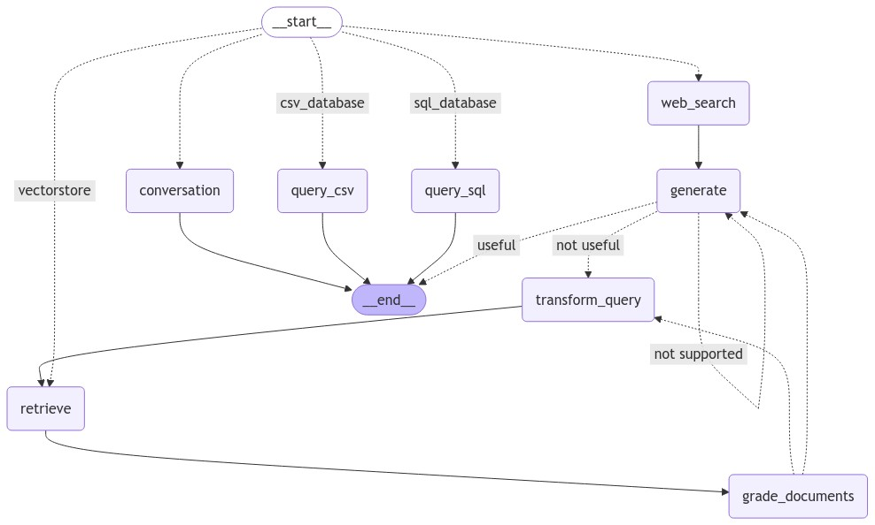





Query requires data summary or calculation
Query is on-topic but unrelated to eBird or historic sighting data
Query is about historical bird sightings
Query requires plot generation
Query is informal
Query is reworded end entered back into text search
Relevant texts are retrieved
Texts are graded on relevance to query

Slide 16
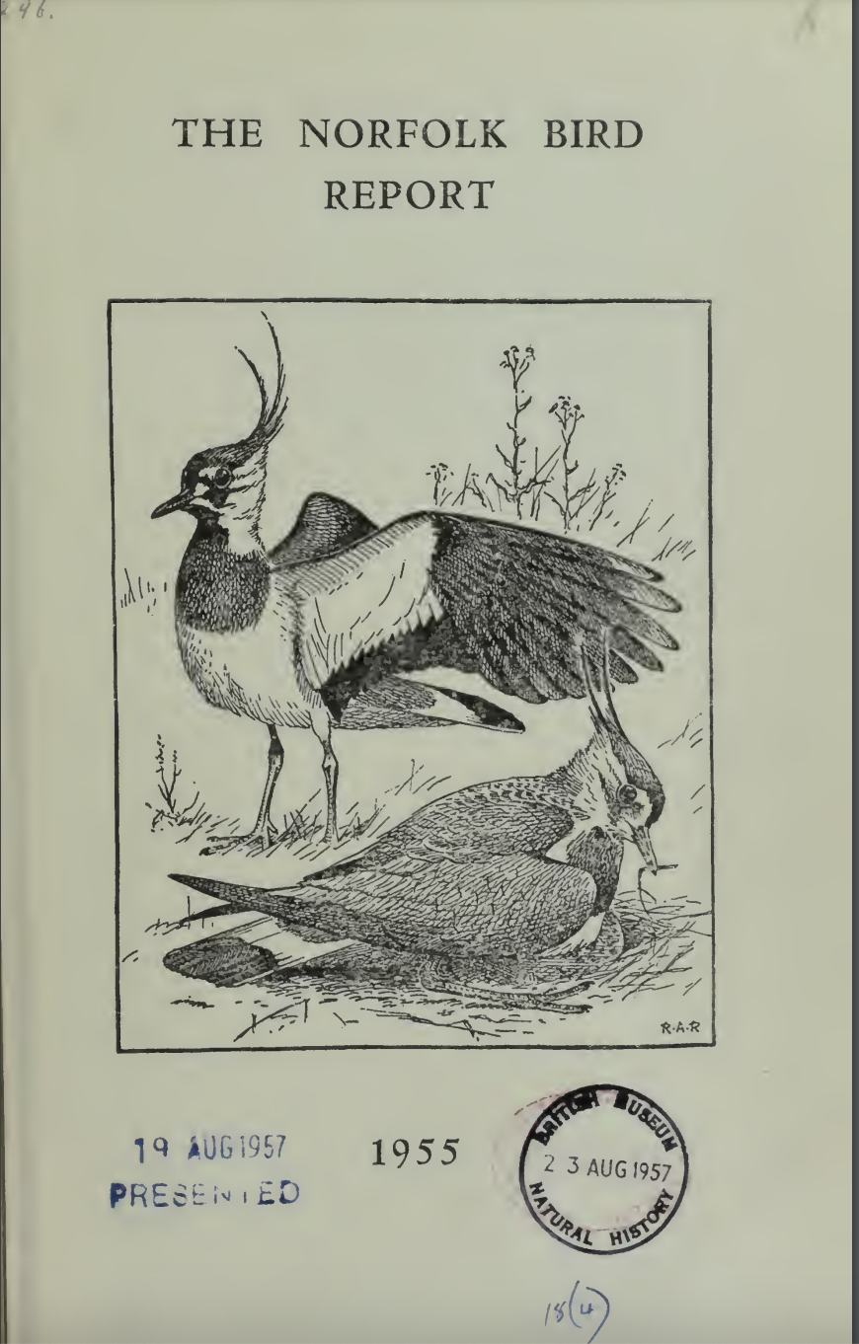
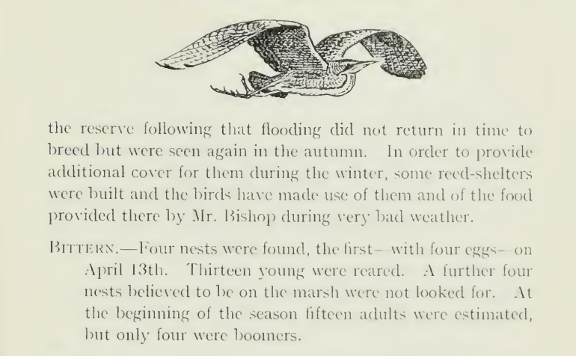
Historical Context

Slide 17
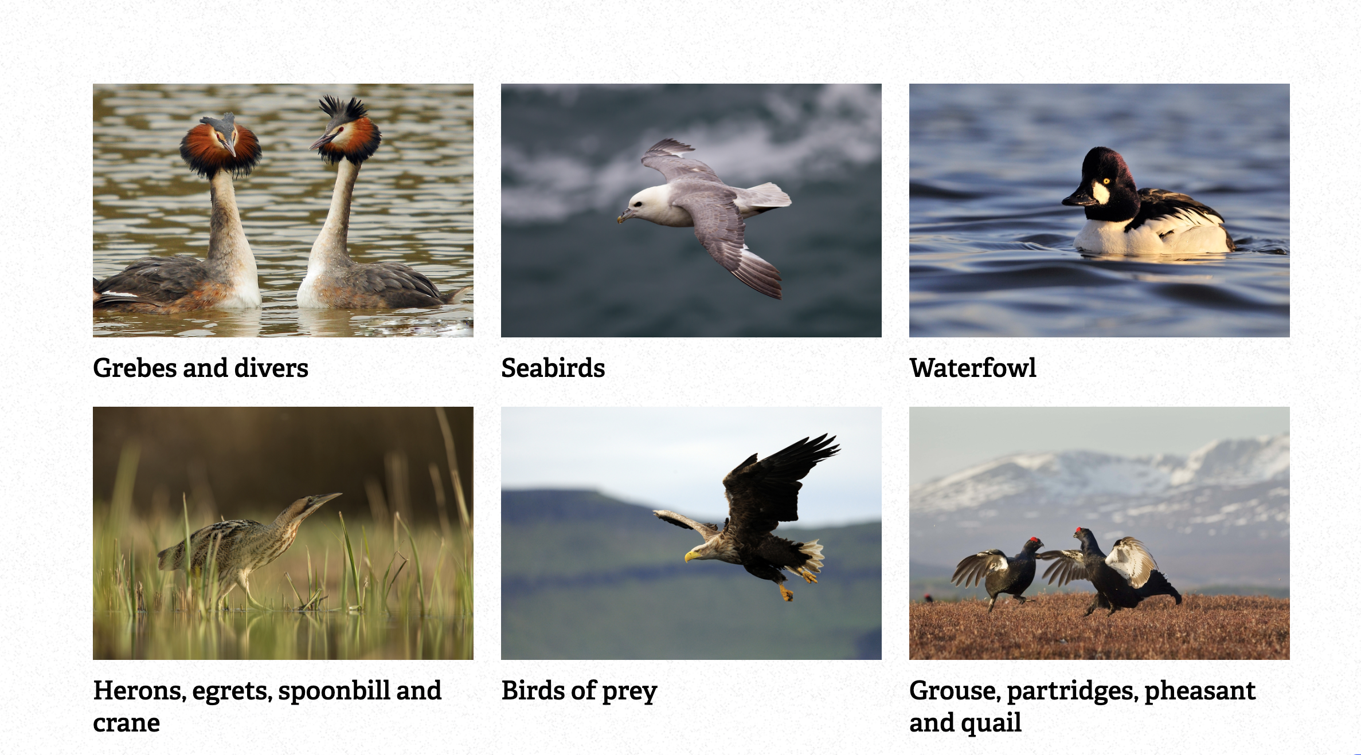
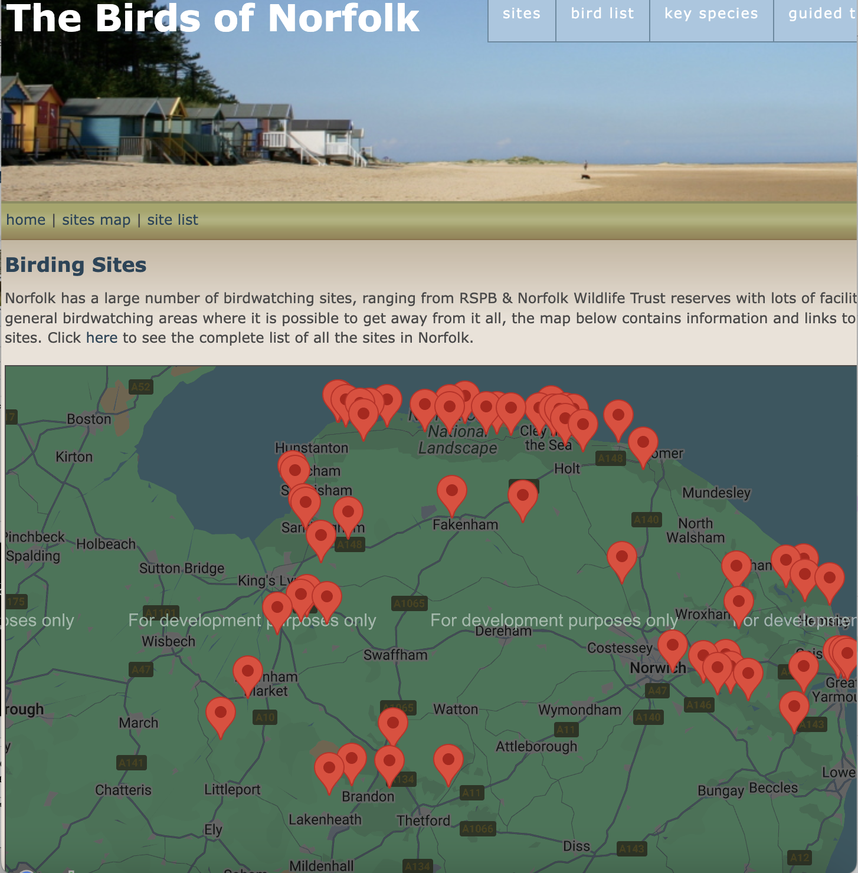
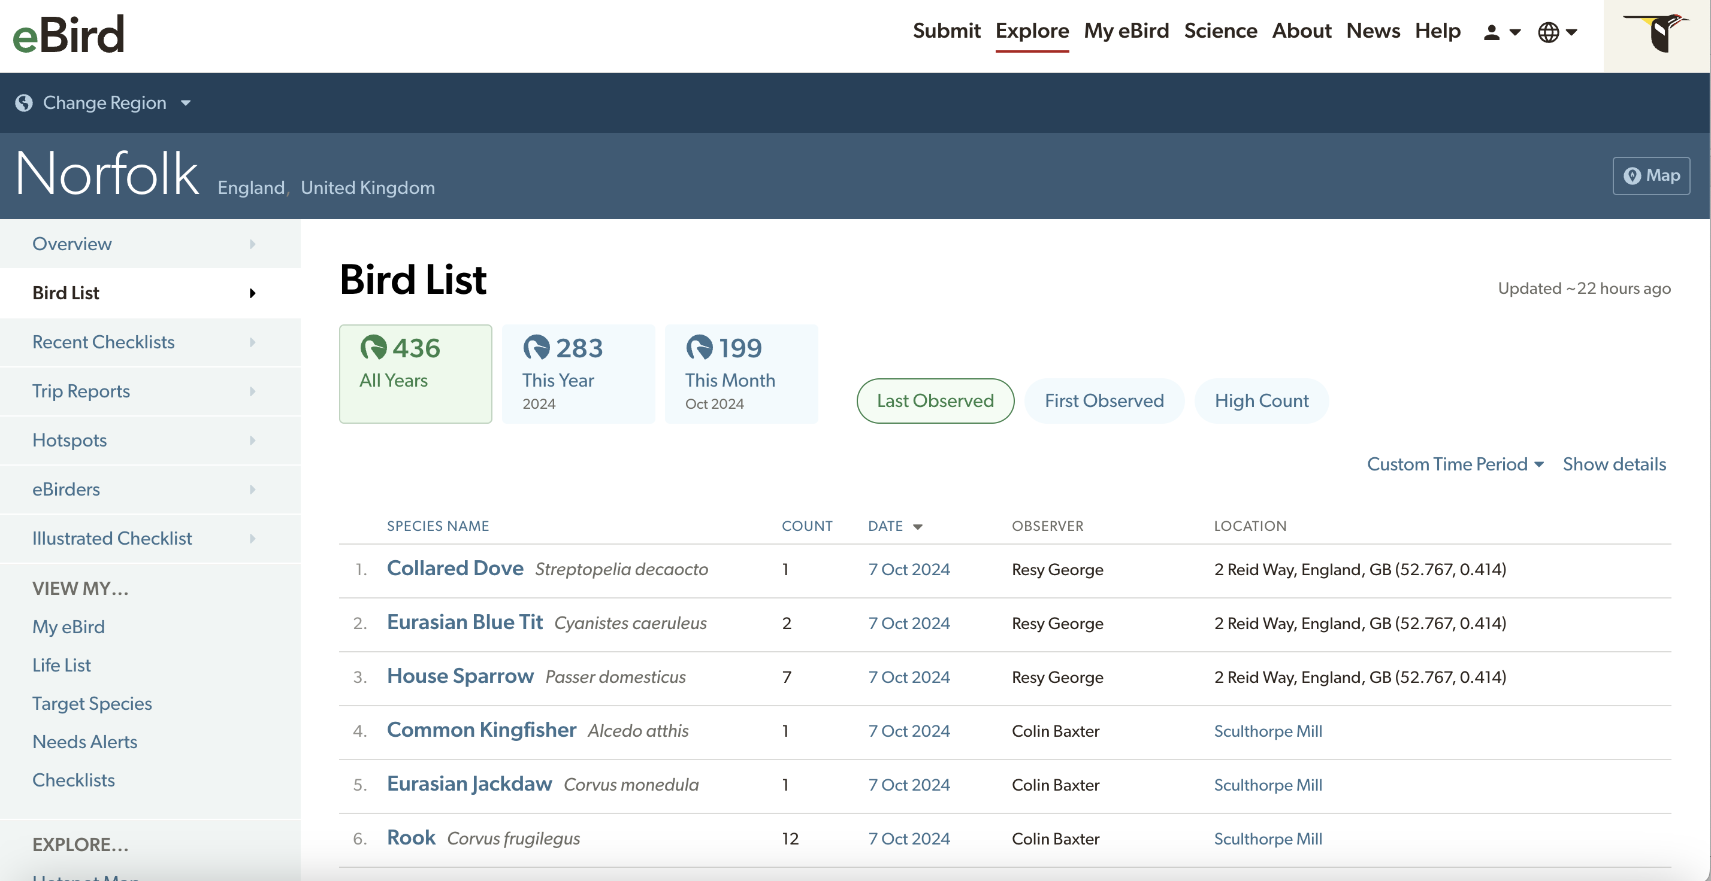
Custom URL List

Slide 18

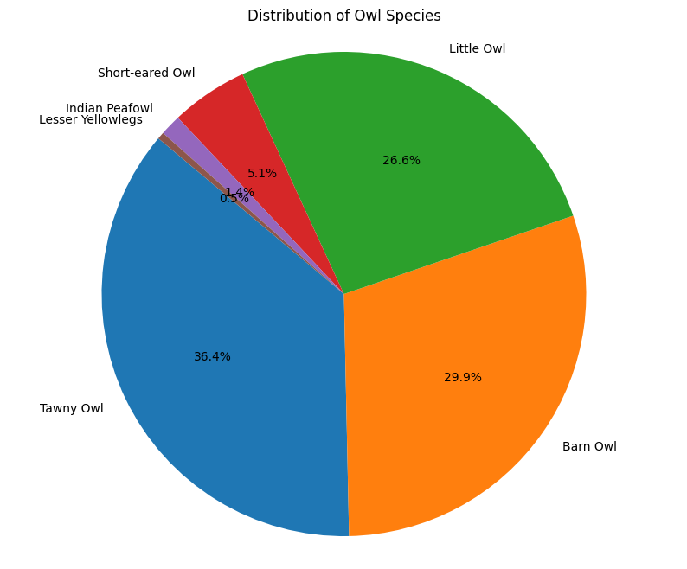
Plotting Data

Slide 19
Plotting Data
Not owls!!

Slide 20
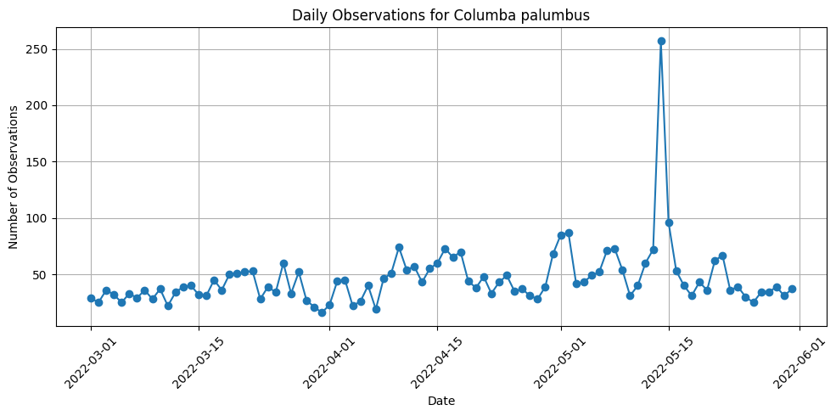
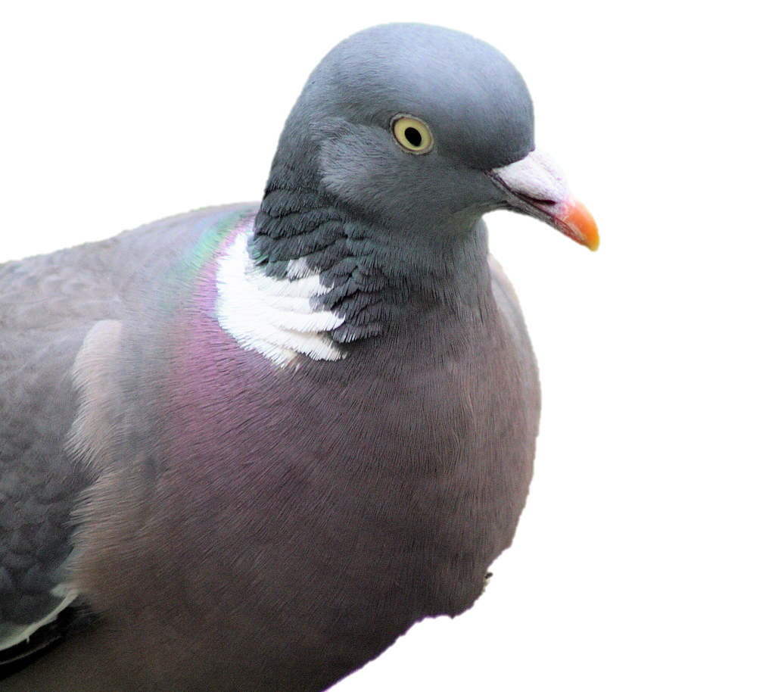
Plotting Data

Slide 21
Plotting Data
Big day for pigeons?
Or a data entry artefact?

Slide 22
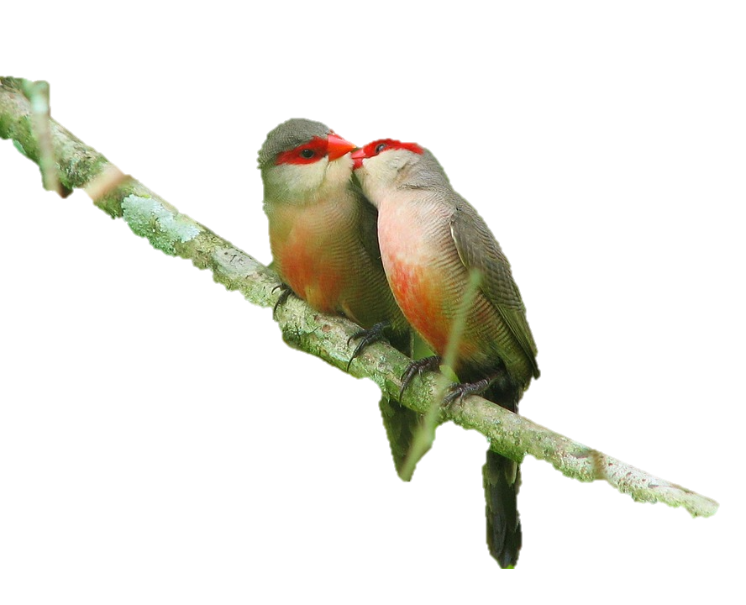
Next steps
Making user interface more user-friendly
Plotting eBird observations onto a leaflet map (getting there!)
Running evaluations on LangGraph – how much does complexity help or hinder the accuracy of the model?
Options for users to extract subsamples of the data
Better integration between present day and historical bird data
Analysis of baseline trends and new trend emergence

Slide 23
With thanks to: Arianna Salili-James, Sanson Poon, Artur Trebski,David Redding
Dr. Elise Gallois
elise.gallois@nhm.ac.uk

